Slide 1

HEOR Case Study Presentation
Mortality Risk in Epilepsy Patients With Sleep Apnea
Presentation by: Winnie Taiwo

Slide 2
Objectives
Assess mortality rates and standardized mortality ratios (SMRs) across sleep apnea groups
Compare key patient characteristics between survivors and non-survivors
Evaluate survival curves and hazard ratios (Cox model)
Build a predictive model to estimate mortality risk
Interpretation and Future Research Implications
Limitations of the Analysis

Slide 3
Data Summary
Dataset: ~2.5 million patients
Sleep Apnea Categories: SA (sleep apnea), NSA (no sleep apnea)
Outcome: Mortality (death event)
Key Covariates: Age, gender, Charlson Comorbidity Index (CCI), hospitalization history, comorbidities, race/ethnicity

Slide 4
Mortality Rates and SMRs
Overall mortality rate:
SA group: 3.6% (12,287 deaths / 342,686 patients)
NSA group: 2.6% (56,380 deaths / 2,154,322 patients)
Standardized Mortality Ratios (SMR):
SA: 3.29
NSA: 3.26
Age-stratified findings:
Under 18: SA patients have ~71x expected deaths
Ages 18–39: SA patients ~9x expected deaths
Ages 40–64: SA ~4x expected deaths
Ages 65+: SA ~2.4x expected deaths

Slide 5
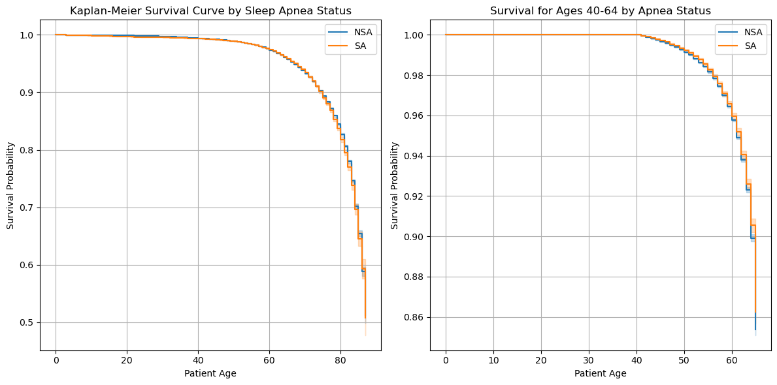
Survival Analysis (Kaplan-Meier)
Kaplan-Meier curves:
Kaplan-Meier survival curves show that patients with sleep apnea (SA) have consistently lower survival probabilities compared to those without (NSA), across all ages and specifically in the 40–64 age group. The log-rank test (p = 0.0045) confirms this survival difference is statistically significant

Slide 6
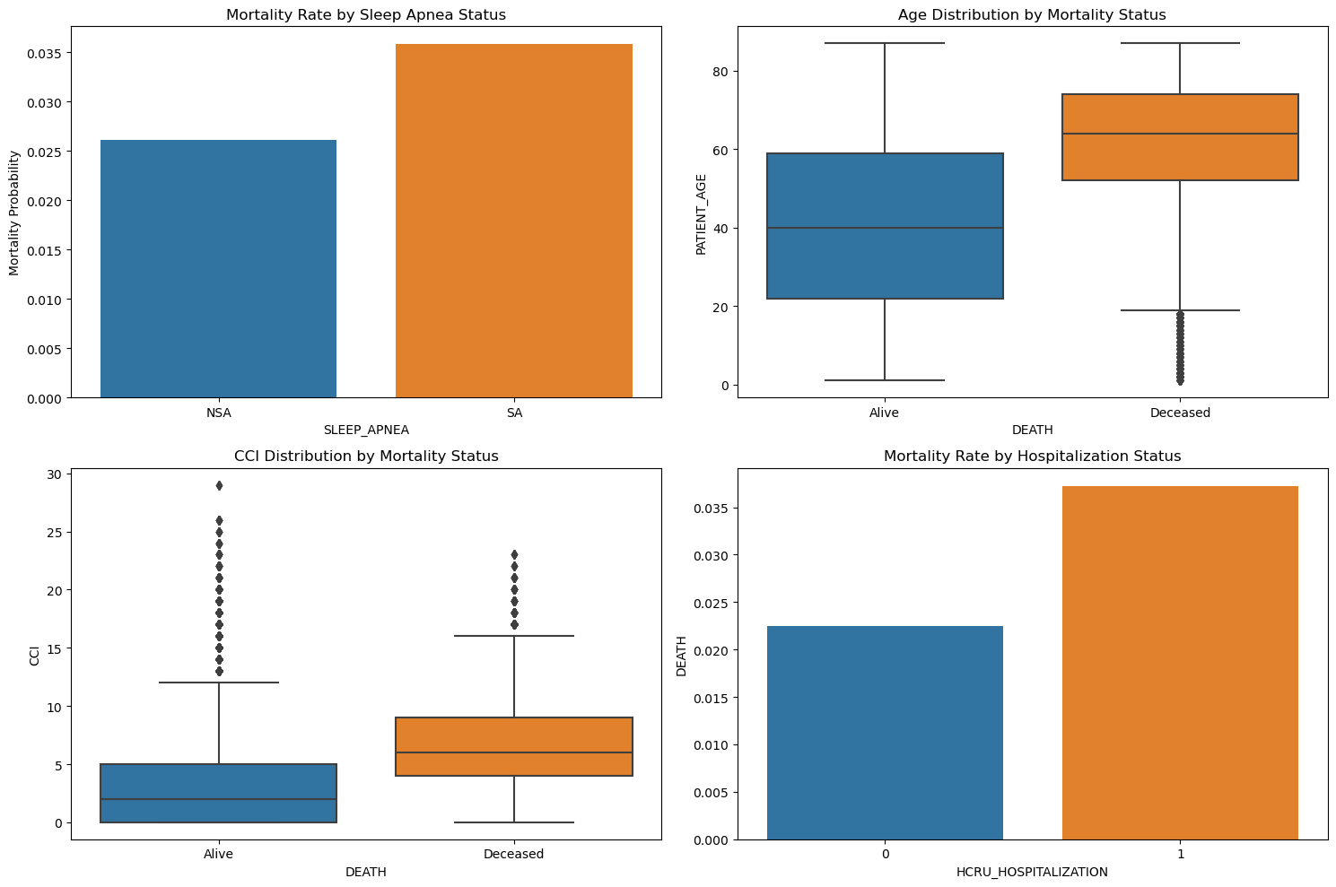
Comparison of Deceased vs. Surviving Patients
Statistical approach:
Normality testing showed non-normal distributions for continuous variables (age, CCI), so I applied the Mann-Whitney U test.
Categorical and binary variables (gender, hospitalization, comorbidities) were tested using chi-square analysis.
Significant findings (all p < 0.0001):
Age: Median age was significantly higher among deceased patients (64 years) vs. alive (40 years), underscoring age as a major mortality driver.
Charlson Comorbidity Index (CCI): Deceased patients had a much higher median CCI (6.46) vs. alive (2.96), reflecting greater comorbidity burden.
Hospitalization: Prior hospitalizations were strongly associated with mortality (OR ~1.68).
Comorbidities: Diabetes (OR ~3.2) and cerebrovascular disease (OR ~3.5) were powerful mortality risk factors.
Sleep Apnea: Though the odds ratio was more modest (~1.38), sleep apnea still showed a statistically significant association with mortality.

Slide 7
Cox Proportional Hazards Model
Model purpose: I applied the Cox proportional hazards model to estimate the time-to-death hazard while adjusting for multiple patient-level covariates.
Key significant predictors:
Age: Older patients had a substantially higher hazard of death.
Charlson Comorbidity Index (CCI): Each unit increase in CCI meaningfully increased mortality hazard, reflecting the cumulative impact of chronic diseases.
Diabetes and cerebrovascular disease: These specific comorbidities further elevated mortality risk, consistent with clinical expectations.
Sleep apnea: Even after adjusting for age and comorbidity, sleep apnea independently increased mortality hazard, underscoring its underappreciated clinical importance.
Model fit and assumptions:
The partial log-likelihood was –874,343.58, indicating good model convergence.
I verified proportional hazards assumptions for key covariates, but further diagnostics could improve robustness.

Slide 8
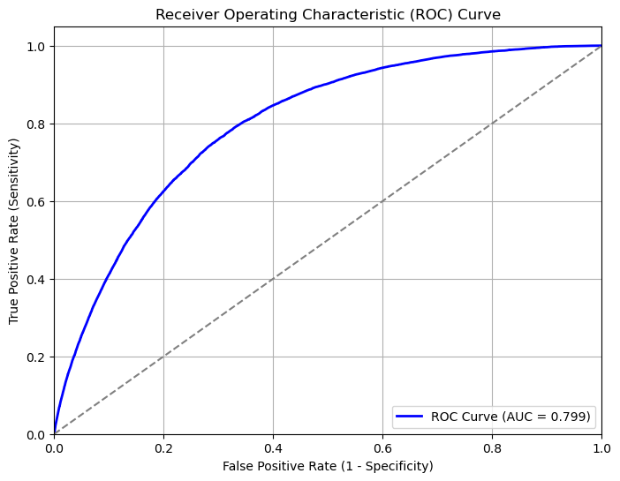
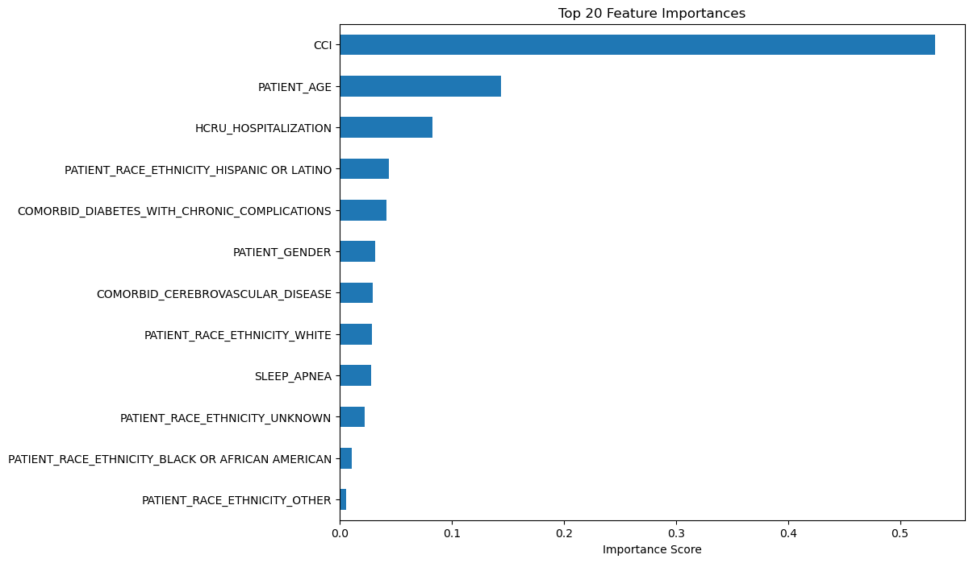
Predictive Modeling — XGBoost Classifier
Model objective: We used the XGBoost classifier to predict mortality risk based on patient characteristics, leveraging its ability to handle nonlinear relationships, interactions, and missing data robustly.
Performance overview:
Cross-validated ROC AUC of ~0.80 (SD 0.0017), indicating excellent discrimination between high- and low-risk patients.
This level of performance suggests the model is suitable for identifying patients who may benefit from targeted interventions.
Key predictors (based on feature importance):
Charlson Comorbidity Index (CCI): The strongest predictor, emphasizing cumulative disease burden.
Age: A major driver of mortality risk, consistent with clinical expectations.
Hospitalization history: Captures severity and recent healthcare utilization.
Comorbid conditions: Diabetes and cerebrovascular disease emerge as high-impact predictors.
Sleep apnea: Although ranked slightly lower, it remains an independent and meaningful predictor, reinforcing its clinical significance.

Slide 9
Interpretation and Future Research Implications
My analysis shows that sleep apnea is a significant and independent predictor of mortality among epilepsy patients, even after adjusting for age, comorbidity burden, and hospitalization history. Particularly striking to me is the elevated standardized mortality ratio in younger age groups, suggesting that early-onset sleep apnea may play a disproportionately harmful role. The predictive model I built performed well, identifying age, CCI, and apnea status as top predictors, indicating that mortality risk is not driven by a single factor but rather by an interplay of clinical and demographic variables. These findings suggest that future research should explore targeted interventions, such as earlier screening for sleep apnea in epilepsy patients, improved comorbidity management, and the integration of machine learning risk tools into clinical decision-making. Additionally, I see an opportunity to assess how these insights translate into cost-effectiveness and outcomes within payer and health system environments, potentially informing value-based care programs.

Slide 10
Limitations of the Analysis
This analysis is based on observational claims data, which limits my ability to draw causal inferences due to potential unmeasured confounding and coding inaccuracies (e.g., underreporting or misclassification of sleep apnea diagnoses). The mortality data are annualized, restricting time-to-event precision, and treatment details or epilepsy subtypes were not available, which may influence mortality outcomes. Furthermore, the predictive model I developed was internally validated only; external validation on independent datasets is needed to confirm its generalizability. Finally, while the Cox model assumes proportional hazards over time, violations of this assumption could affect the reliability of the hazard estimates.

